Slide 1
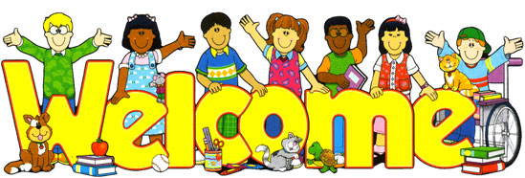

Slide 2

UNIT 2: DAYS
LESSON 7: WRITING - A SPECIAL DAY

Slide 3
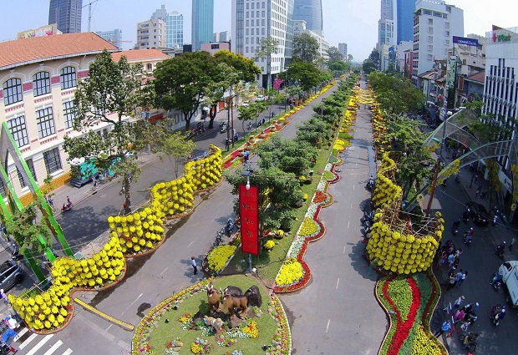
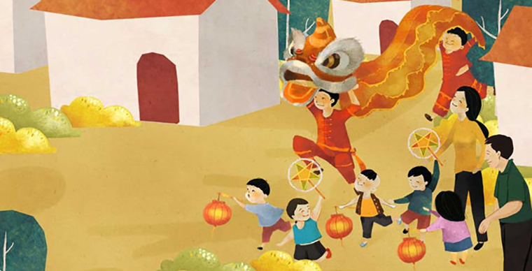
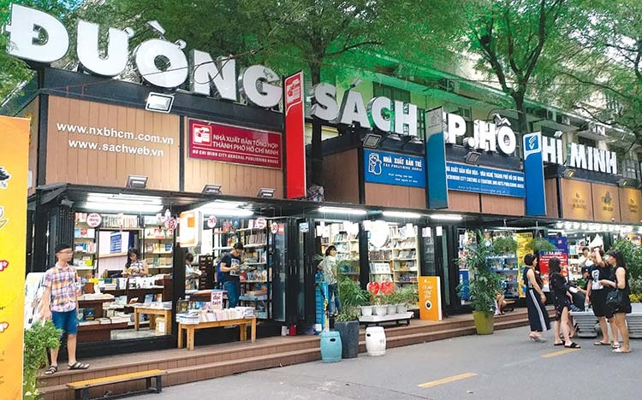
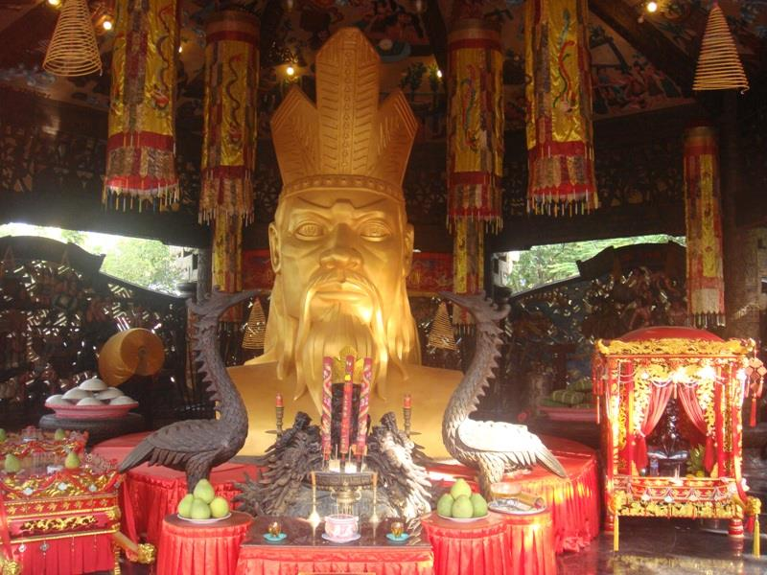
Nguyen Hue Flower Street Festival
Mid-Autumn Festival
Book Reading Festival
King Hung's Commemoration

Slide 4

Why do you like this special day?
What do you do?
Who do you celebrate with?

Slide 5
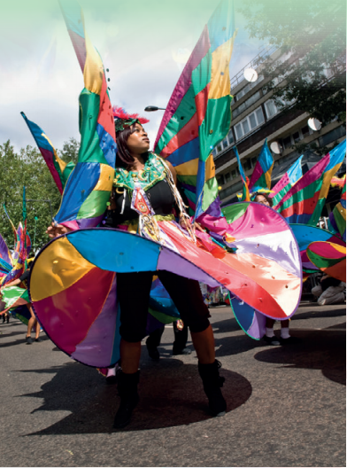
EXERCISE 1: Describe the photo

Slide 6
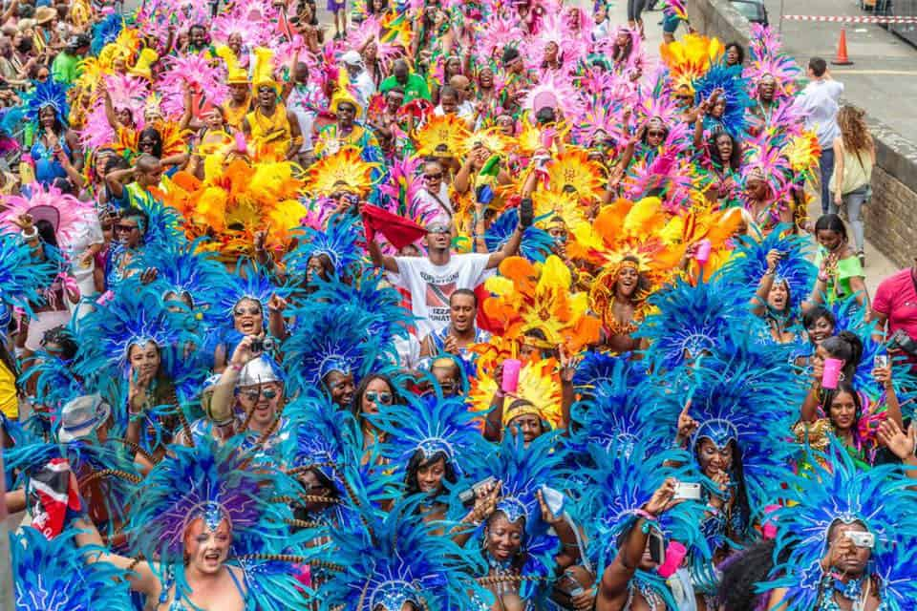
EXERCISE 2:
The carnival is in Notting Hill, London in August.
People wear costumes, play music and dance.

Slide 7
EXERCISE 3: Look at the text and complete the key phrases
the Notting Hill Carnival
1. You can enjoy.............................................. .
2. Local people celebrate................................... .
3. There are .......................in the street.
4. It's a lot of......... .
Caribbean culture
big parades
fun

Slide 8

Language point: also
is adverbs, means "in addition"
We use "also" in the normal mid position for adverbs:
→ between the subject and main verb, or after the modal verb or first auxiliary verb
→ after be as a main verb. In this position, the meaning of also usually connects back to the whole clause that comes before:
Eg: She works very hard but she also goes to the gym every week.
Eg: He is also becoming a teacher.

Slide 9
EXERCISE 4: Look at the words in blue in the text. How do you say also in your language? Then choose the correct words.
We buy presents. We have also / We also have a family meal.
There are fireworks. There's also / There also is a concert.
- I like school, but I also like / I like also the holidays. My birthday
is in April. My sister's birthday also is / is also in April.

Slide 10
Optional activity: writing with books closed
 | Rewrite the sentences adding also to each one
1. I love the costumes and I enjoy the music.
1. I love the costumes and I also enjoy the music.
2. The carnival is colorful and it's fun.
2. The carnival is colorful and it's also fun.
3. People sing in the streets and they dance.
3. People sing in the streets and they also dance.
4. At the end of the day I'm very happy and I'm tired.
4. At the end of the day I'm very happy and I'm also tired.

Slide 11
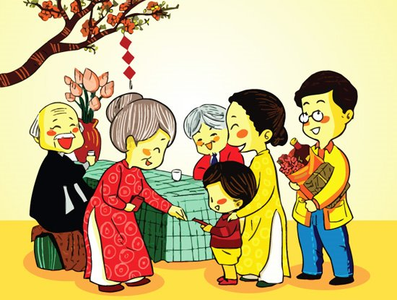
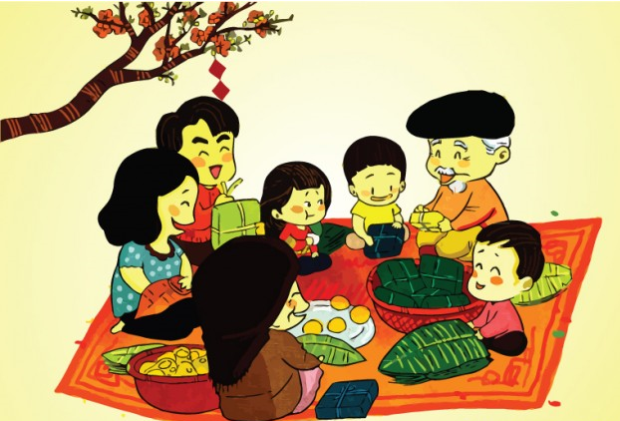
EXERCISE 5: Work in group
→ What's the celebration?
→ What do people do?
→ What do you usually do?
→ What do you like or dislike about it?

Slide 12

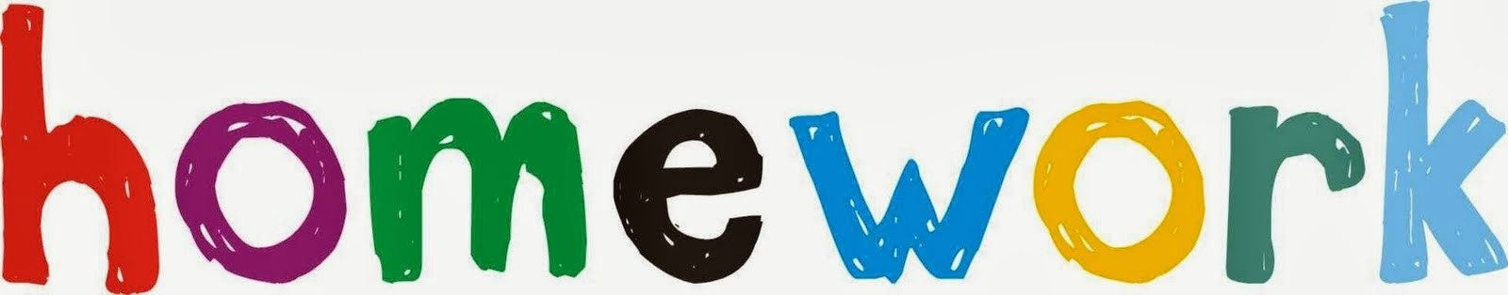
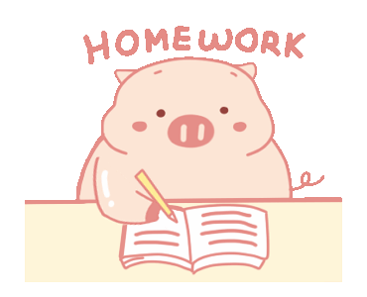
- Learn by heart all the new words and the structure.
- Prepare for next lesson.

